Slide 1






LaCulture

Slide 2










The Team
Aidan LaBrano
Landon Walls
Royce Paul
Nicholas Luke
Felix Schafer
Scrum Master
Project Manager
Design/UI Lead
Quality Assurance
Development
Lead

Slide 3



Table Of Contents
1
2
3
Why our website matters
Website Capabilities
Our
final product
Who is this for? Why would people use it?
What can it do? How can it be used?
A display of our full project.

Slide 4





What is LaCulture?
LaCulture is a website made to help people outside and inside of Louisiana learn about its culture! The website is made to be an all-in-one website that has everything you need to plan your visit, explore the state, and live Louisiana culture!

Slide 5




Framework Used
Front End
Angular 20.2.x
Typescript
UI components
Angular Material
Core UI
Additional Libraries
Leaflet.js (map)
RxJS (state management)
Back End
.NET framework
C#
SQL for local database

Slide 6

Why LaCulture?
Some people may not know much about the great state of Louisiana or some do know some of its history and want to know more
You have friends and need to find something to do
Or maybe you have no friends and want to find a place to make some
You want to cook a cultural recipe but don’t know any

Slide 7
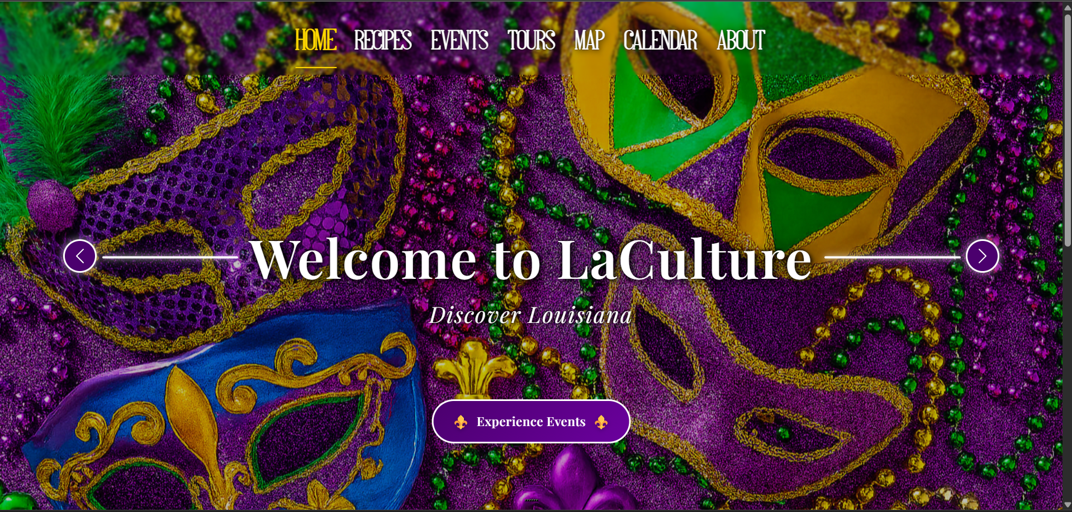
1

Slide 8
Home Page:
The Home page features a slideshow of images relating to Louisiana’s culture and gives users a glimpse of what Louisiana has to offer
A quicklinks section offers users with quick access to different Events and popular locations around the state

Slide 9
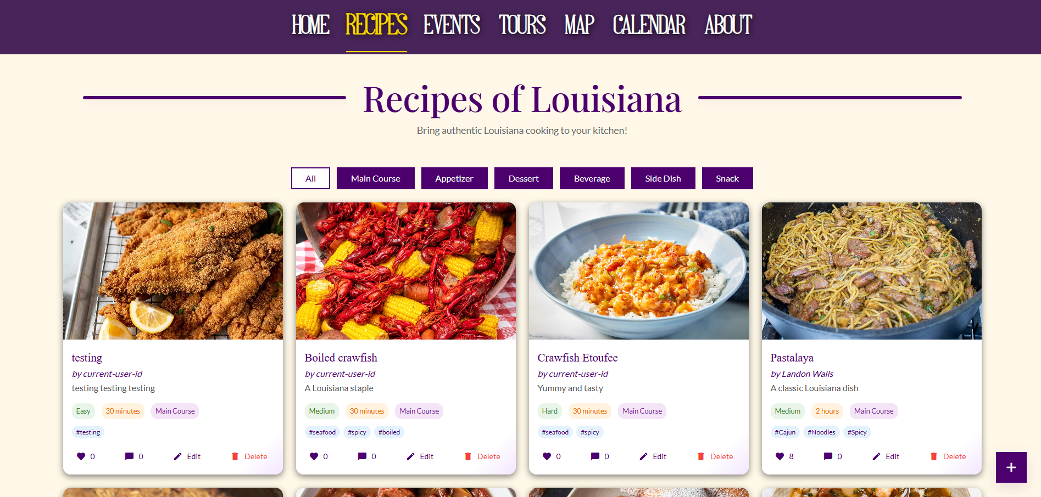
1

Slide 10
Recipes Page:
A Recipes forum that allows users to view and post their favorite recipes, getting users in touch with the rich culinary culture of Louisiana
Features:
Posting
Filtering options
Like and comment functionality

Slide 11
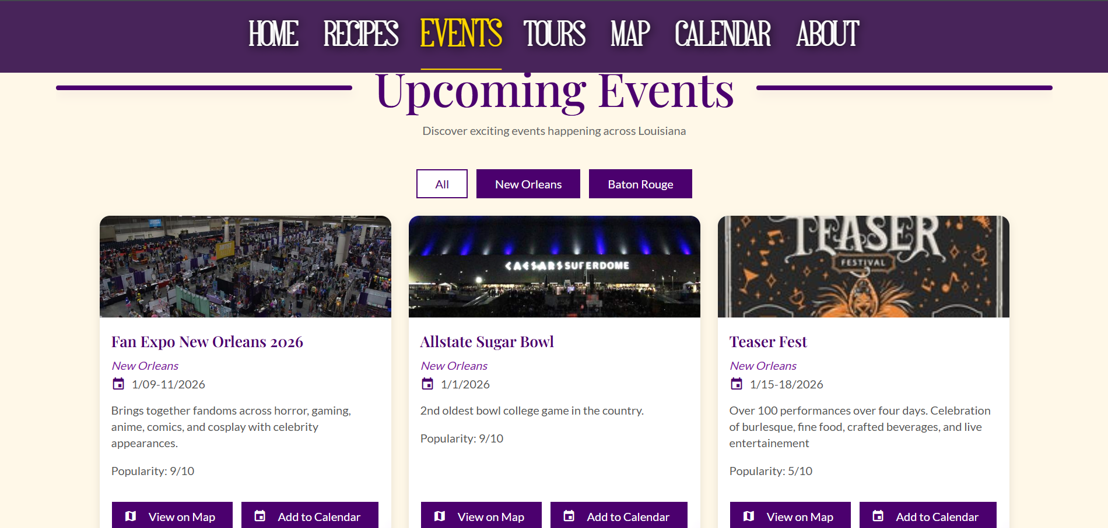

Slide 12
Events Page:
An Events listing page that allows users to view what events are happening in Baton Rouge and New Orleans
Features:
Name, Location, Date, and Popularity of each event listing
Filtering options
View on Map option
Add to Calendar option
Visit Website button

Slide 13
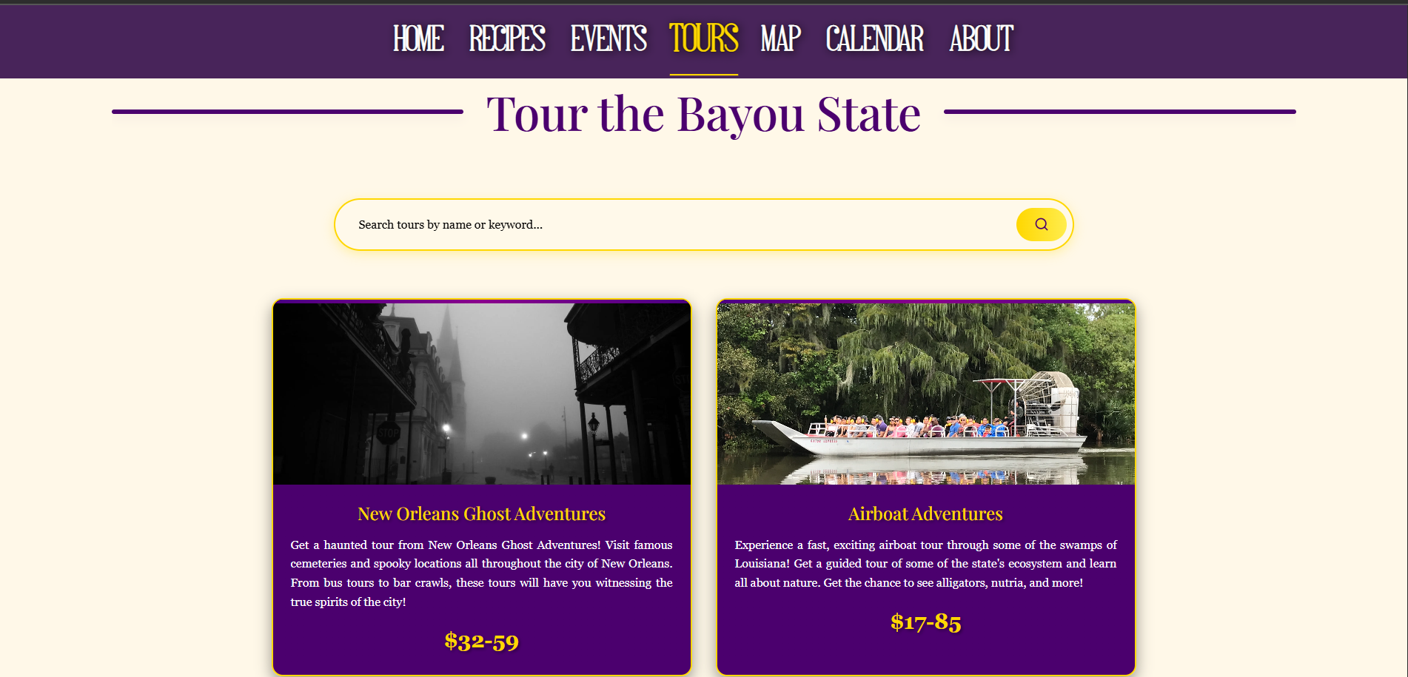
1

Slide 14
Tours Page:
The Tours page will help in providing users will a fast, easily accessible way to look at tours offered throughout each city.
Our plan would be to contact and work with these various tours to get them directly connected to customers from our site instead of using cluttered, complexed sites like TripAdvisor
A search bar is set up at the top of the page with keywords that users to type to find tours revolving around their interests.
Each card is set up to give a brief description and average price value to showcase the tours.

Slide 15
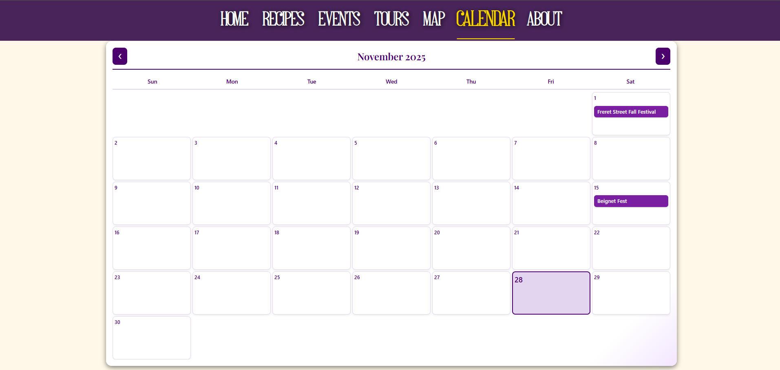
1

Slide 16
Calendar Page:
The Calendar Page allows users to see scheduled events laid out on a calendar
Users can also export events to calendars such as:
Google Calendar
Outlook
Yahoo Calendar
ICS File Download

Slide 17
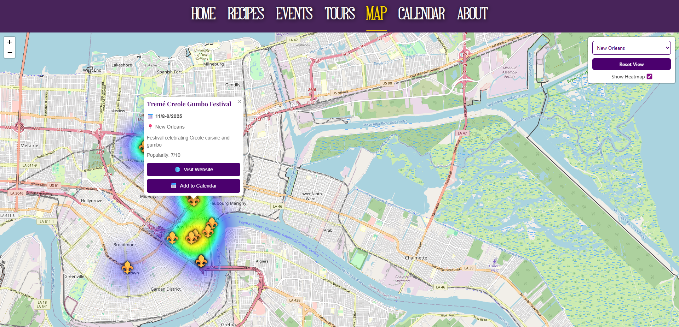

Slide 18
Map Page:
The map page enables users to locate events on an interactive map of Louisiana.
The user can select different views, such as New Orleans, Baton Rouge, and a full view of Louisiana.
There is an optional heatmap, which allows the user to easily view what areas are the most popular.
Clicking on any point on the map reveals a tooltip similar to what is seen on the Events page, allowing the user to view the location’s website and add it to a calendar.

Slide 19
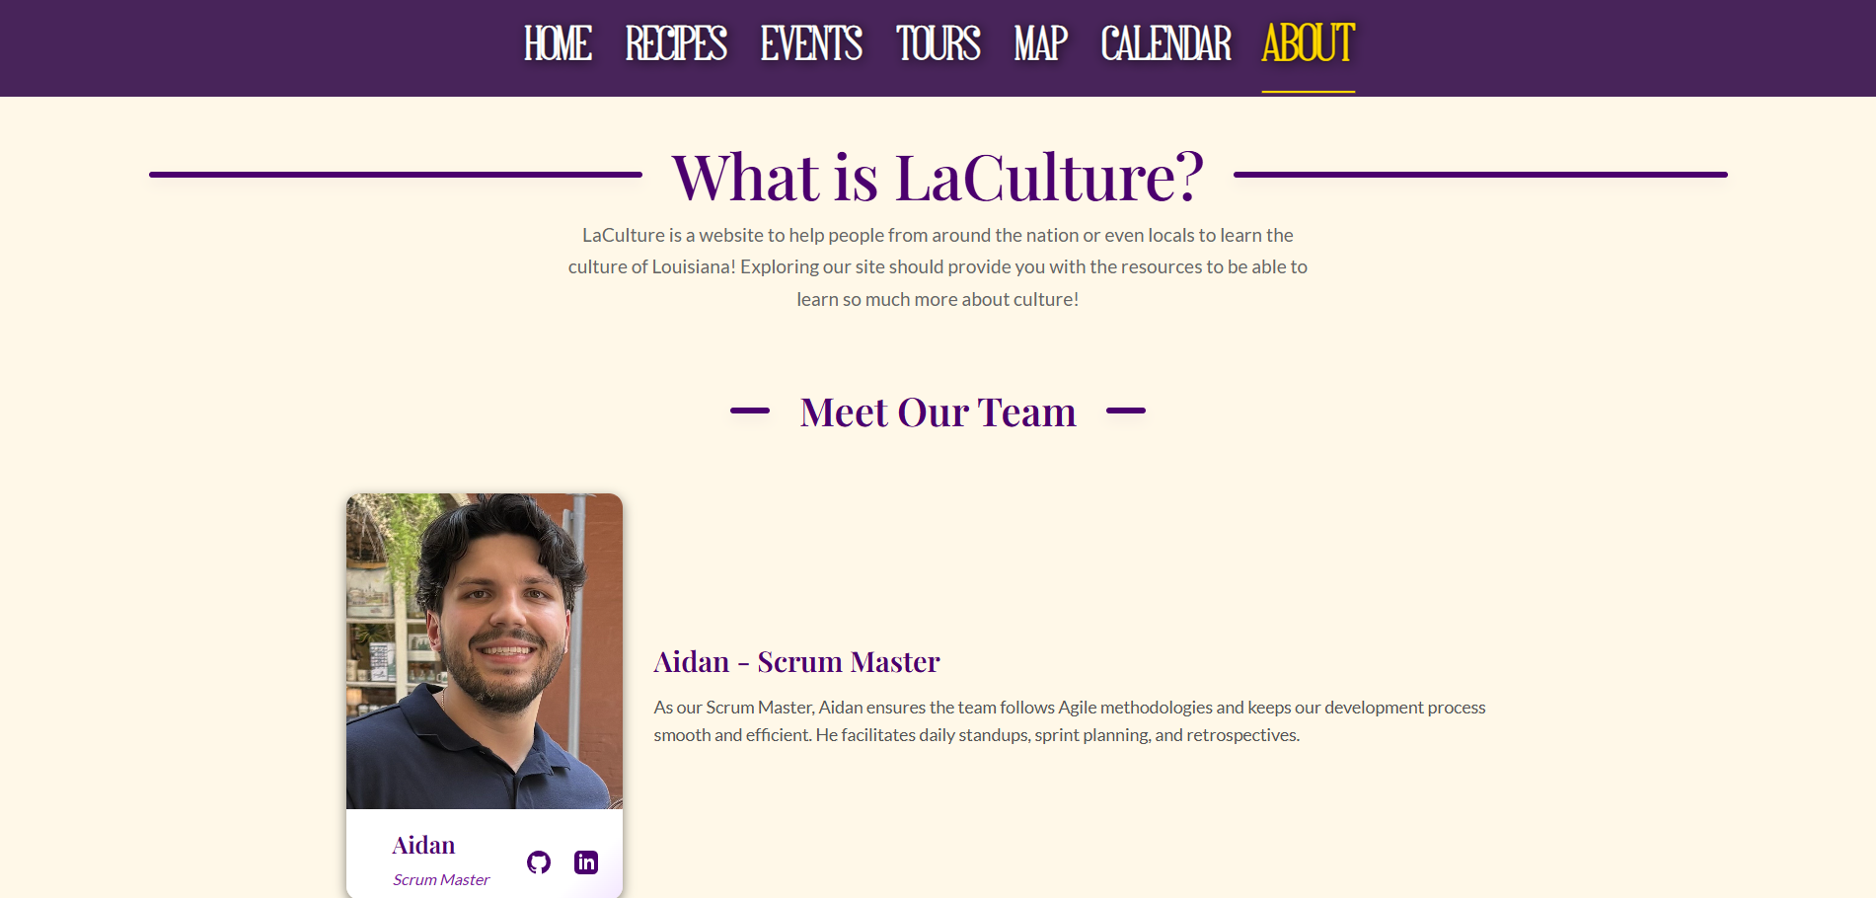

Slide 20
About Page:
Short and simple page that allows us to get in contact with any investor, customer, or company that wants to work with us.
Also allows us to get feedback from future users and what they want from the website

Slide 21



Future Plans
Integrating an LLM chat
Mobile Optimization
Interfacing with EventBrite API
Using an LLM like Gemini or ChatGPT on our site
Optimizing our site to be used on mobile devices.
Pulling in Events from EventBrite’s API, to keep our Events up to date

Slide 22
Live Demo

Slide 23
Commercial
https://youtu.be/nHZV2Gs2hvg?si=tiYUh0inXx6C_nlL

Slide 24
Thank you!

Slide 25

Credits
SlidesCarnival for the presentation template
Pexels for the photos
Pixabay + Wayne Toups for commercial audio

